Slide 1

Welcome
to
3rd Grade
Math EOG
Jeopardy!

Slide 2
Round 1
Final
Jeopardy
Team
1
Team
2
Team
3

Slide 3
Fraction
Measure and Data
Geometry
Algebra
Base Ten
100
100
100
100
100
Final Jeopardy
200
200
200
200
200
Scores
300
300
300
300
300
400
400
400
400
400
500
500
500
500
500

Slide 4
100
What fraction of the figure is shaded?

Slide 5
100
5/6
Scores

Slide 6
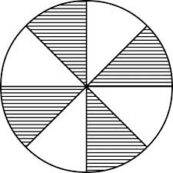
200
Jenna shaded 4/8 of the circle below. What is another way to name the fraction of the figure shaded?

Slide 7
200
1/2
Scores

Slide 8
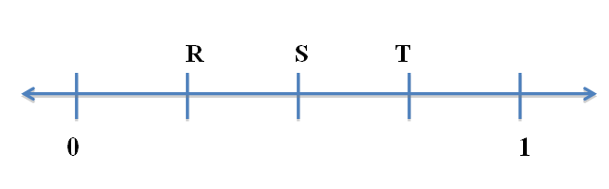
300
The number line below is divided into equal parts.
What is the distance from R to T on the number line?

Slide 9
300
2/4
Scores

Slide 10
400
Caden, Darren, and Cameron had a jumping contest to see how far they could jump across the hallway. Who jumped the furthest?
Caden jumped 4/6 way across
Darren jumped 3/6 way across
Cameron jumped 6/6 way across.

Slide 11
400
Cameron jumped the furthest because he jumped all the way across the whole hallway.
6/6 = 1
Scores

Slide 12
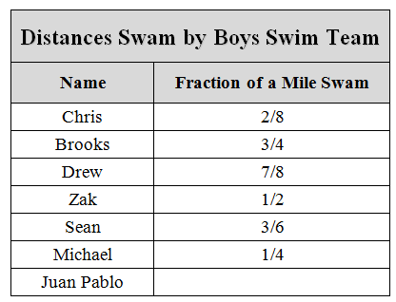
500
Which two boys swam the same amount?

Slide 13
Chris and Michael
swam the same amount.
Zak and Sean swam the
same amount.
500
Scores

Slide 14
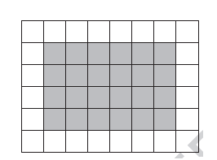
100
Kyle found the area of the shaded part of the figure by counting the total number of shaded tiles.
What other way could he have found the area?

Slide 15
100
By multiplying 6 and 4
Scores

Slide 16
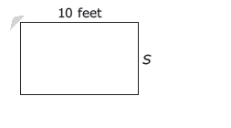
200
A rectangular room has a perimeter of 36 feet. One side is 10 feet long.
How long is side S?

Slide 17
200
8 feet
Scores

Slide 18
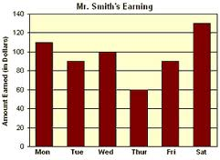
300
The graph below shows Mr. Smith’s Earnings in a week.
How many fewer
dollars did
Mr. Smith
earn on Thursday
than on Friday?

Slide 19
300
$15
Scores

Slide 20
Daily
Double

Slide 21
400
Draw a line plot to correctly display the data from the chart beside.
Height in Inches | Number of Boys
40 | 1
40 ½ | 2
41 | 4
41 ½ | 1
42 | 3
42 ½ | 5
43 | 0
43 ½ | 3
44 | 1

Slide 22
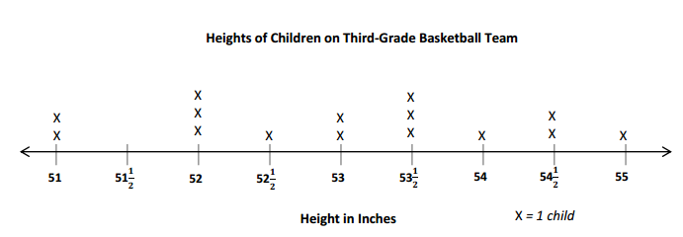
400
Scores

Slide 23
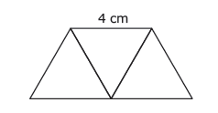
500
The polygon below is made of three triangles. The length of each side of each triangle is 4 cm.
What is the perimeter of the polygon?

Slide 24
20 cm
500
Scores

Slide 25
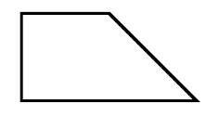
100
Which category describes the figure below?

Slide 26
Trapezoid
100
Scores

Slide 27
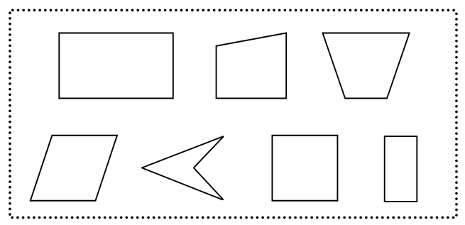
200
Brian says all of these shapes are rectangles because they have 4 sides.
Is he correct?

Slide 28
No, because a rectangle is a shape
that has 4 sides with 4 right angles.
200
Scores

Slide 29
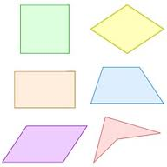
300
How are all of these shapes alike?

Slide 30
300
They are all quadrilaterals.
Scores

Slide 31
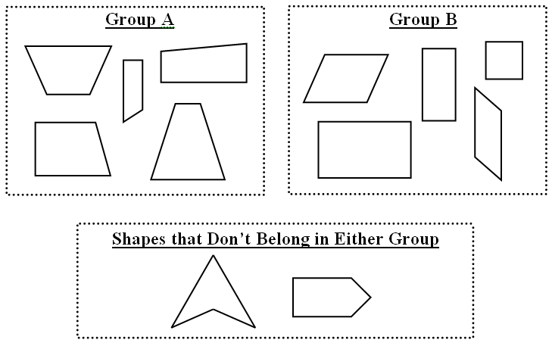
400
The following shapes were sorted into groups. What rule was used to sort the shapes?

Slide 32
400
Group A contains trapezoids.
Group B contains parallelograms.
Scores

Slide 33
500
Ben wants to partition his garden into thirds. Show one way he can do that?

Slide 34
500
Accept all equal partitions that show thirds. Rectangle should be divided into equal parts.
Scores

Slide 35
100
What rule is used to make the pattern below?
72, 64, 56, 48, 40, . . .

Slide 36
100
Subtract 8 each time.
Scores

Slide 37
200
There are 24 boxes. Two of the boxes are empty. Each of the other boxes contains 2 erasers. How many erasers are there altogether?

Slide 38
200
44
Scores

Slide 39
300
Which multiplication fact is equal to this expression ?
(6 x 5) + ( 6 x 5)

Slide 40
300
12 x 5
Scores

Slide 41
400
Gina has a total of 32 marbles.
  She has an equal number of pink, yellow, green, and white marbles.
  She will put the marbles into 2 cups.
  She will put an equal number of each color in each cup.
  How many GREEN marbles will be in each cup?

Slide 42
400
4
Scores

Slide 43
500
Mrs. Parrish has 3 sisters.
  She mailed 2 cards to each of her sisters in October.
  She mailed 4 cards to each of her sisters in November.
  The expression (2 x 3) + (4 x 3) could be used to find the total number of cards she mailed to her sisters.
Write another expression that could be used to find the total number of cards mailed to her sisters.

Slide 44
500
3 x (2 + 4)
Scores

Slide 45
100
There are 248 third graders and 336 fourth graders at the school assembly. How many third and fourth graders were at the assembly?

Slide 46
100
584 students
Scores

Slide 47
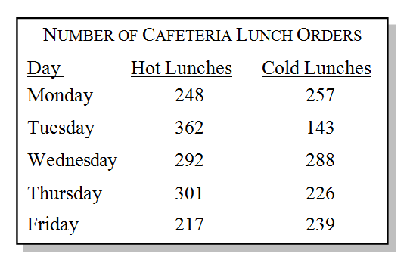
200
What day was number of hot lunches about the same number as cold lunches?

Slide 48
200
On Wednesday
Scores

Slide 49
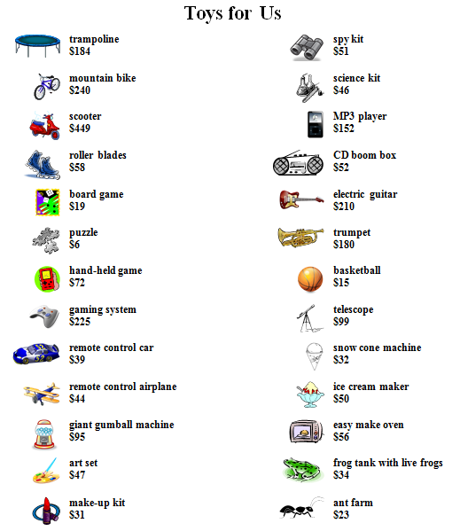
300
About how much money would be spent if you bought an electric guitar, a telescope, and a gaming system?

Slide 50
300
Around $500
Scores

Slide 51
400
There were 755 students taking the EOG in the school. 355 were fourth graders and 245 were fifth graders. How many were third graders?

Slide 52
400
157 third graders
Scores

Slide 53
500
Megan decided to make a batch of cookies. She made 15 cookies and wanted to split them into 5 equal groups. She decided to put 2 cookies in each group. Did she make 5 equal groups? Explain.

Slide 54
500
No. She should have put 3 cookies in each group. She only used 10 of the cookies by putting 2 cookies in each group.
Scores

Slide 55
Final
Jeopardy
Test Taking
Final Jeopary Question
Scores

Slide 56
Which weighs more?
A pound of apples or a pound of cotton?

Slide 57
They both weigh the same… a pound!
Be sure to read carefully and think about every question before you answer!
Scores

